Slide 1
Smart Water Sensor System for Water Purity Monitoring
Developed by (Group 7):
Urja Panchal [21101631]
Rushi Raval [21086166]
Nidhi Patel [21087749]
Date: 07/29/2024

Slide 2
01
Introduction
02
Implementation
03
Demonstration
Table of Contents
04
Challenges, Limitations &
Future Work
05
Questions

Slide 3
01
Introduction

Slide 4

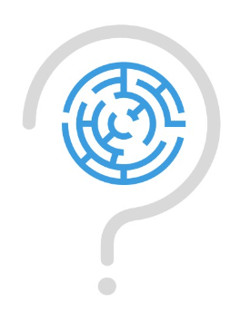
Motive of the Project
PROBLEM
SOLUTION
Traditional Water purity measuring process require manual sampling & lab analysis which are time consuming and lacks real-time monitoring.
There is a need for a smart, automated system that can continuously monitor and assess water quality parameters in real-time that Can trigger immediate alerts when water quality parameters exceed safe levels.

Slide 5
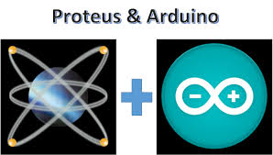
Project Overview
Simulation for the concept of a smart water bottle cap for real-time water purity monitoring system.
Utilizes sensors to measure TDS, temperature, turbidity, and water level.
Integrates Arduino microcontrollers and wireless communication.
Simulated using Proteus software.

Slide 6
Project Objective
Design a cost-effective sensor system for real-time measurement of water purity units.
Develop a wireless network to connect multiple sensor nodes for comprehensive monitoring.
Implement data acquisition and digital data display on virtual terminal.

Slide 7
Project Relevance
Why is it Important?
Why is it Intresting?
Efficiency: Replaces labor-intensive and time-consuming traditional methods with an automated, real-time system.
Scalability: Offers a low-cost, scalable solution for widespread water quality monitoring.
Innovation: Demonstrates the potential of IoT technologies in enhancing water quality management.
Exploring IoT: Showcases the potential of IoT and smart wireless systems in addressing real-world problems.

Slide 8
02
Implementation

Slide 9
Overview of the Implementation
Integrating Sensor nodes into wireless sensor network
Research/Contex: Literature Review
04
01
03
02
Virtual prototyping of sensor nodes using Proteus
Tools & Libraries

Slide 10
01.
Literature Review:
Need for Sensors:
Real-time Monitoring, Contamination Detection, Public Health & Sustainability
Role of Proteus:
Virtual Simulation, Sensor Compatibility, Design Refinement & Testing
Network Connection:
Wireless Communication, Data Transmission, Real-time Analysis
04
01
03
02

Slide 11
02.
04
01
Tools & Libraries
03
02
Simulation: Proteus, Arduino IDE
Microcontroller: Arduino UNO
Sensors: TDS, Turbidity, Water Level
Libraries: Virtual Wire

Slide 12
03.
Virtual prototyping of sensor nodes using Proteus
Node 1 | Node 2 | Node 3
TDS Sensor | Turbidity Sensor | Water Level Sensor
TDSSensor.LIB | TurbiditySensor.LIB | WaterSensor.LIB
04
01
03
02
Each sensor circuit is connected to an Arduino UNO along with a (transmitter component).

Slide 13
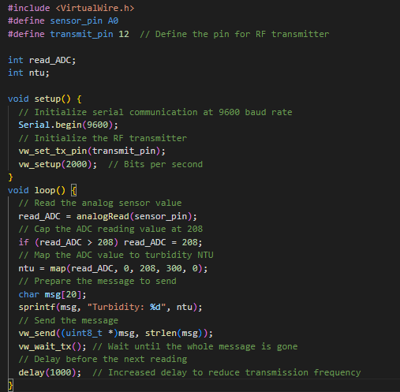
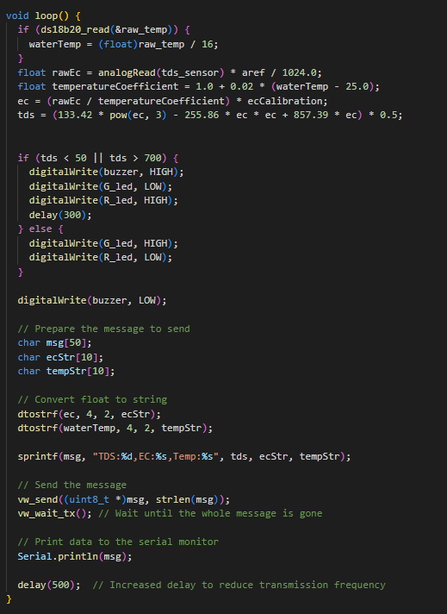
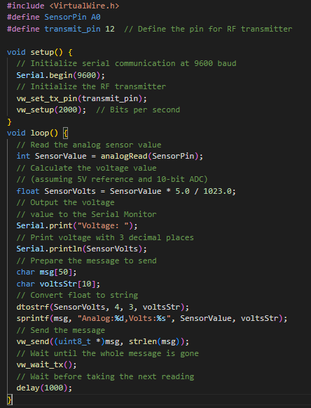
Turbidity Sensor:
Function: Measures the cloudiness or haziness of water, indicating the presence of suspended particles.
Data Collection: Reads an analog value from the sensor and maps it to a turbidity range (NTU).
Output: Provides turbidity value in NTU (Nephelometric Turbidity Units).
TDS (Total Dissolved Solids) Sensor:
Function: Measures the concentration of dissolved solids in water.
Data Collection: Reads raw electrical conductivity (EC) values, adjusts for temperature, and converts EC to TDS using a polynomial equation.
Output: Provides TDS, EC, and water temperature values.
Water Level Sensor:
Function: Measures the water level using an LC circuit.
Data Collection: Higher water level results in higher voltage and lower resistance.
Output: Provides voltage value corresponding to the water level.

Slide 14
04.
Integrating Sensor nodes into wireless sensor network
04
01
This setup allows for efficient wireless communication between the sensor nodes and the central component, enabling real-time monitoring and display of water quality parameters.
03
02

Slide 15
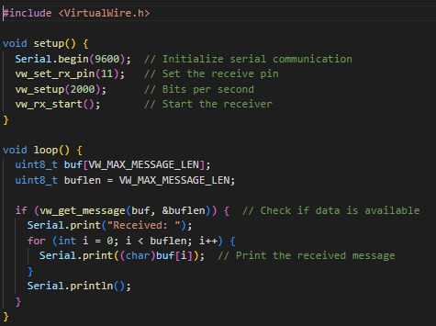
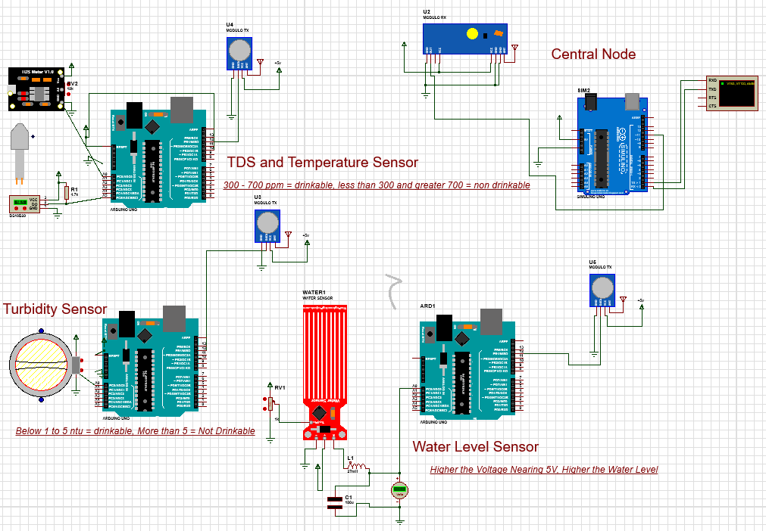
Wireless Communication:
Uses VirtualWire library.
Enables data transmission from sensor nodes to central component.
Central Component:
Consists of a receiver and Arduino.
Acts as the hub for data collection.
Data Flow:
Sensor nodes transmit data wirelessly.
Central component receives all sensor data.
Displays collected data on virtual terminal.
Virtual Terminal:
Connected to the central component.
Provides real-time display of sensor readings.

Slide 16
03
Demonstration

Slide 17
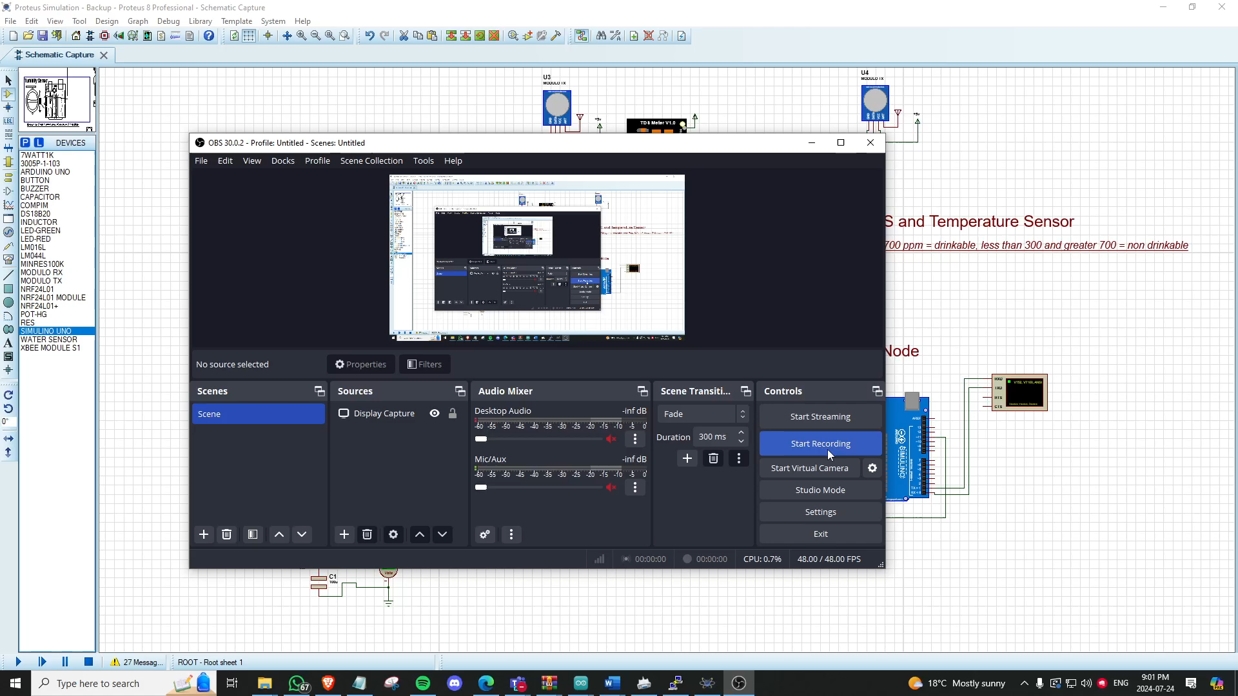
Simulation

Slide 18
04
Challenges & Limitations

Slide 19
Challenges & Limitations
Challenges:
Sensor integration with Arduino.
Transmitter and receiver connections.
Accurate data aggregation and display.
Finding libraries for wireless communication.
Limited support for wireless components in Proteus.
Limitations:
Proteus lacks components for wireless connection simulation.
Inability to simulate wireless network scalability.

Slide 20

Future Work
Miniaturization for water bottle cap integration.
Redesign of sensors and circuitry for compact form factor.
Portable, personal water quality monitoring solution.
Research into miniaturization techniques and power management.
User interface design for effectiveness and user-friendliness.
Integration with mobile app for data visualization and alerts.
GPS-based clean water source locator feature.
Real-time water quality information for end-users.

Slide 21
Questions
Q1 - Why did we Proteus over other simulation tools?
Q2 - Can you walk us through how we created a 'conversation' between our sensors and the central node in Proteus?
Q3 - What exactly are TDS, Turbidity, and water level telling us about water quality, and why was it important to simulate these in real-time?

Slide 22
THANK YOU

